Slide 1
Track Corona NearMe
Project by SSS

Slide 2

AGENDA
The purpose of this project is to track active COVID-19 cases on a map using cell phone/tracking bracelet. Nearby people and local police can be notified if quarantine is violated by infected case. This will help provide safety, control the spread of virus and avoid the need for lockdown.
OVERVIEW
Testing & Collecting data
Tracking (Bracelet / cellphone)
Notify (Maps and SMS)
Contact tracing

Slide 3
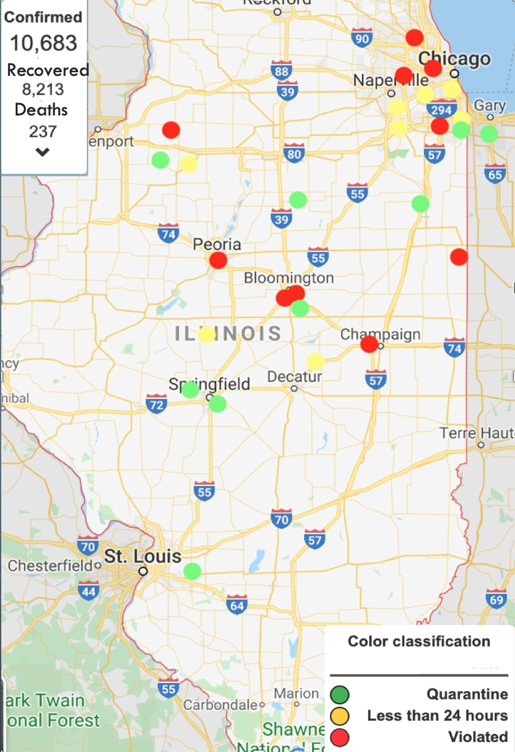
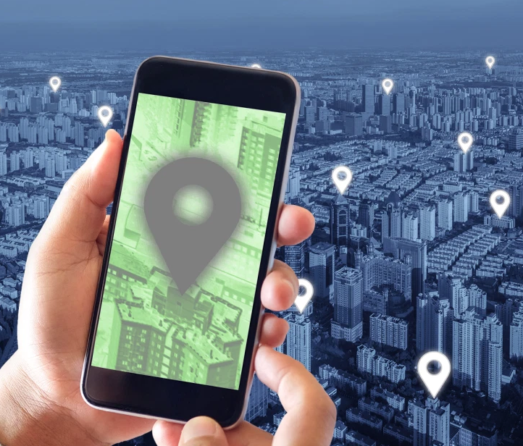


<Patients>
<Patient id="1" name="Billy" tracker_code="a123" date_detected=”04/21/20 12:10 pm" age=“52” address=”xyz” Phone=”xxx">
<Tracker tid="1" tracker_code="a123" lat="-33.86" lng="-151.22" date="2020-04-21" record_time="1:05 pm"</Tracker>
<Tracker tid="2" tracker_code="a123" lat="-32.86" lng="-145.22" date="2020-04-21" record_time="1:15 pm"</Tracker>
</Patient>
</Patients>
Mobile Tracking
Bracelet Tracking
COVID-19 case alert
(6:00 pm – 6:20 pm) Costco, Schaumburg, IL
Friday, April 24. Avoid going for next few hours.

Slide 4
Testing & Collecting data
Test maximum people using fast test kits
If detected positive collect patient's data (Name, address, phone etc)
Assign tracking bracelet till recovery
Tracking (Bracelet / Cellphone)
Using tracking bracelet and cellphone we will constantly collect the coordinates of the active cases and store it in our database
Notify (Maps and SMS)
Using coordinates we will track the positive cases in maps
If quarantine violated
We will show with red mark in maps
Alert police or local public around with travel log (location, timing and duration)
Contact tracing
Identify persons who came in contact with infected person and do testing

Slide 5
How can this help ?
Can control spread of COVID
By alerting people around if its safe to go to any store or place they want to visit
Be able to check any presence of infected case in last 24 hours.
Taking preventive measures for unaffected people the lockdown can be avoided and help people not lose jobs.
Can help Contact tracing, which is to identify people who shared common space with infected and test them.
Other areas it could help
Any contagious virus like Ebola
If tracking is limited to government, it could help track suspects.
Could be limited between doctor’s and patients

Slide 6
Questions & Comments

